Slide 1



Final Presentation
Group-2
Gayathiri.S
TRIPATHI SUPRIYA BANSHGOPAL
LAVANKULA MOHAN SURYA PAVAN KUMAR

Slide 2





Structure the final presentation in PPT format, following a logical order
Report Preparation and final Submission
0
Final Presentation & Report Preparation
Group Details – Team members and roles.
Project Summary – Brief overview of objectives and impact.
KPI List – Key performance indicators and their business relevance.
Excel Dashboard – Initial findings and data trends.
Tableau Dashboard – Interactive visualizations and insights.
Power BI Dashboard – Advanced analytics and performance tracking.
SQL Query Image – Schema and queries used for data transformation.
Key Takeaways – Business insights, challenges, and future recommendations
2

Slide 3
Project Summary
Objectives and Impact: The Bank Analytics project aimed to build an interactive Power BI dashboard to track key metrics such as loans, deposits, and customer segmentation. It simplified complex data into actionable insights, reduced manual reporting, and improved financial accuracy. With real-time branch and customer performance tracking, managers achieved smarter decisions, stronger risk management, and greater efficiency, ultimately driving profitability and customer-focused strategies.

Slide 4
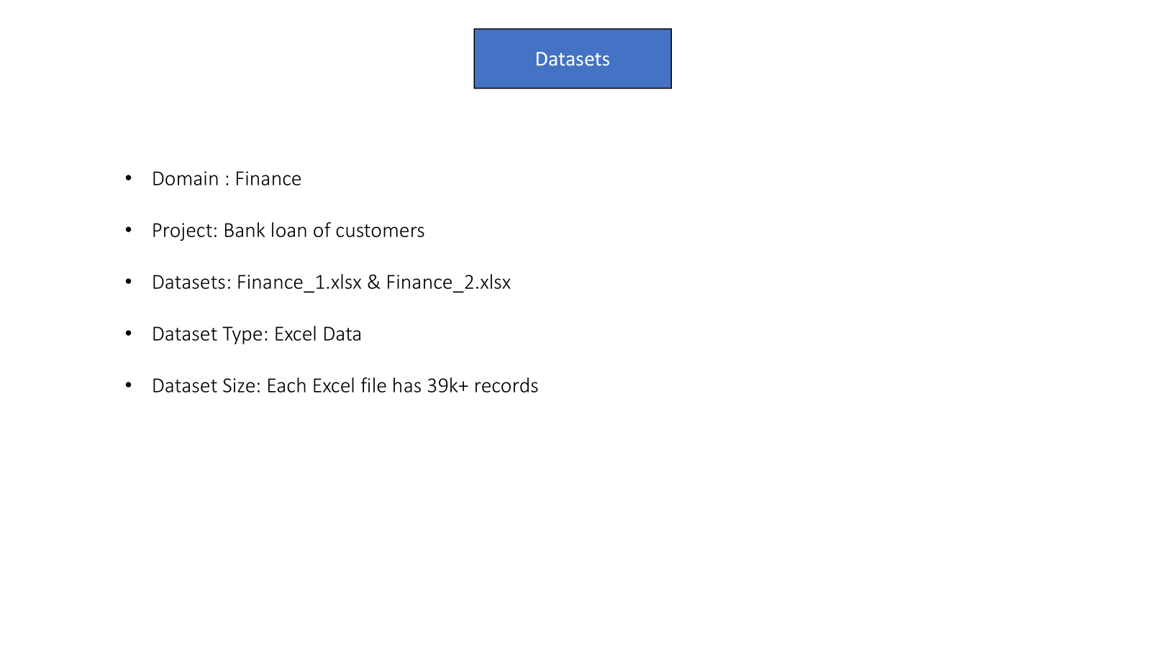
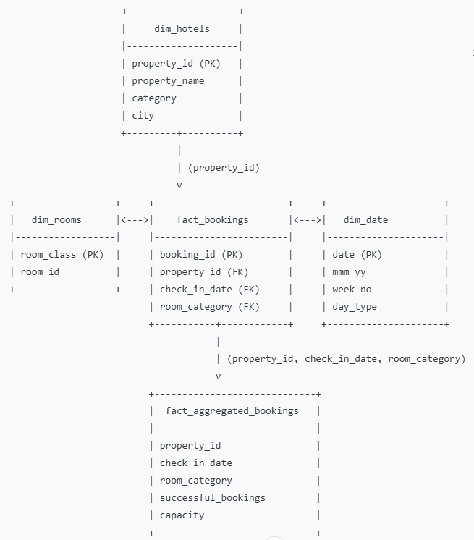
Hospitality Data Model

Slide 5
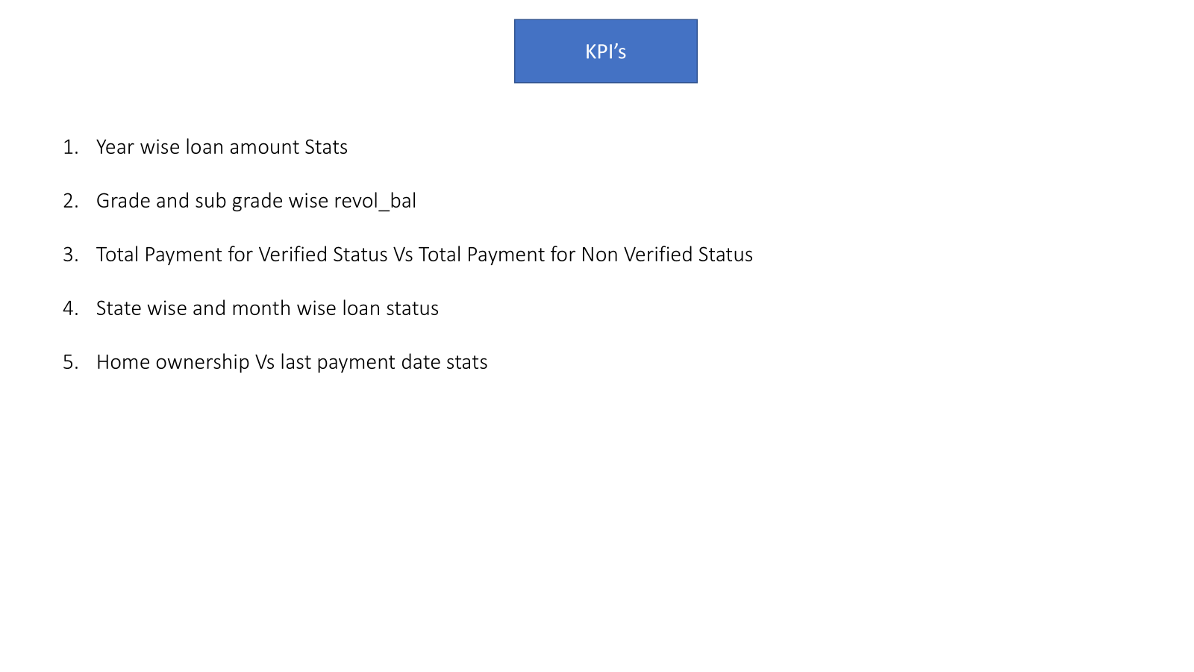
KPI List
Total Revenue
Occupancy Rate
Cancellation Rate
Total Bookings
Utilized Capacity
Booking Trends
Revenue by Room Category
Weekday vs. Weekend Performance
Revenue by State/Location
Check-out / Cancel / No-show Status

Slide 6
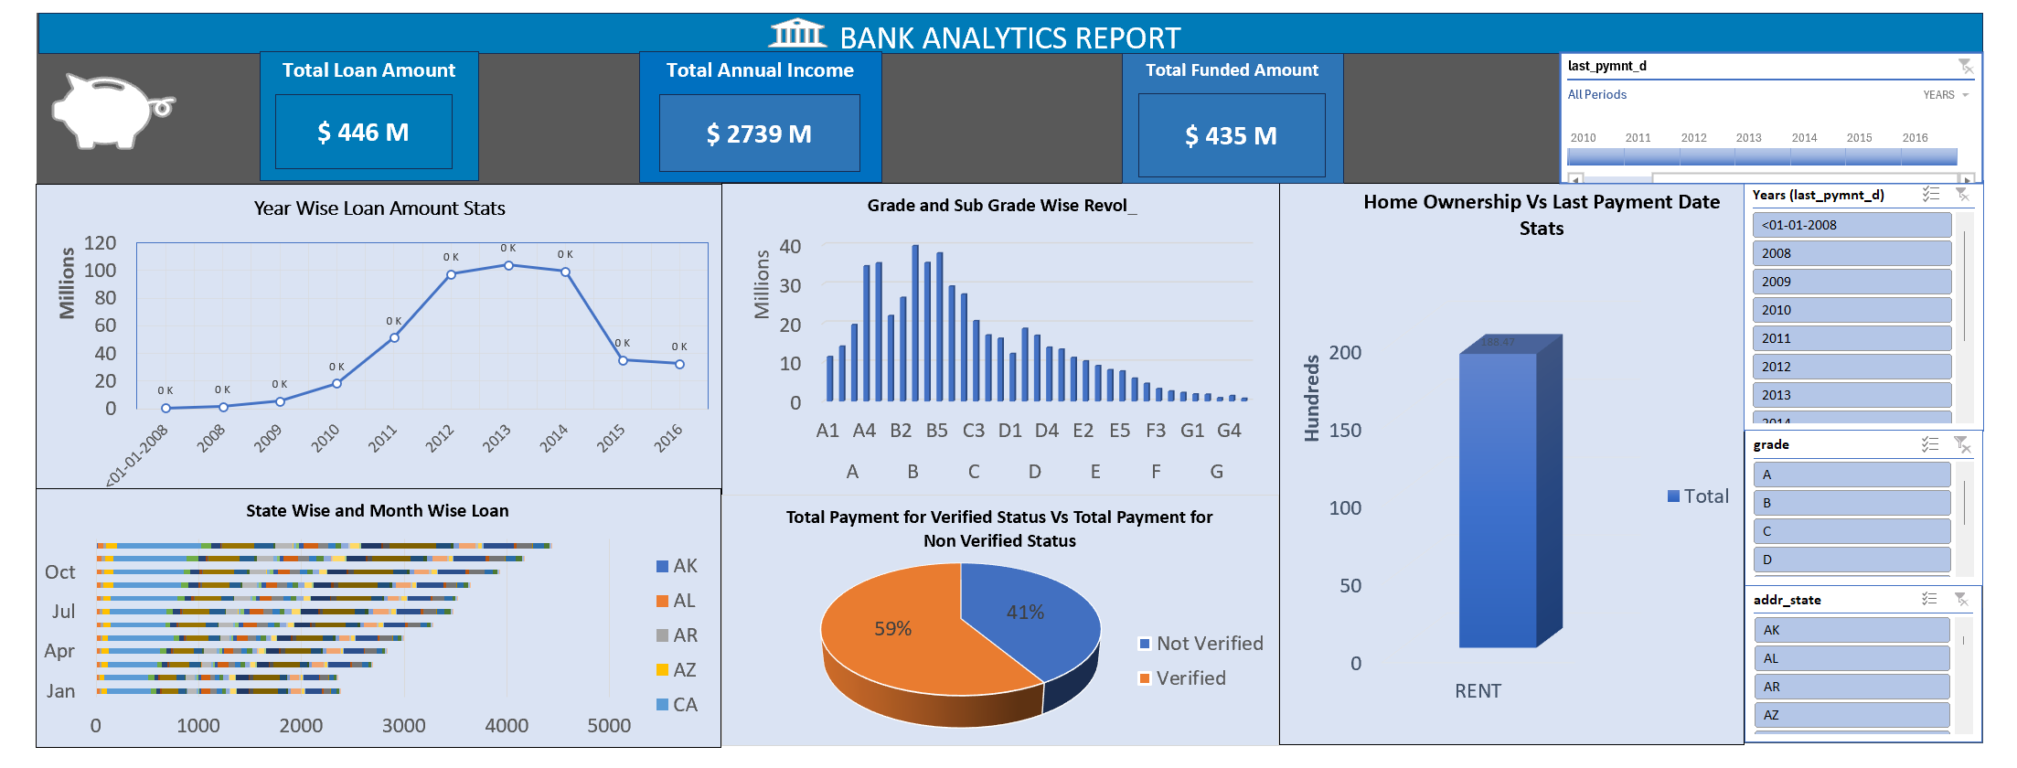
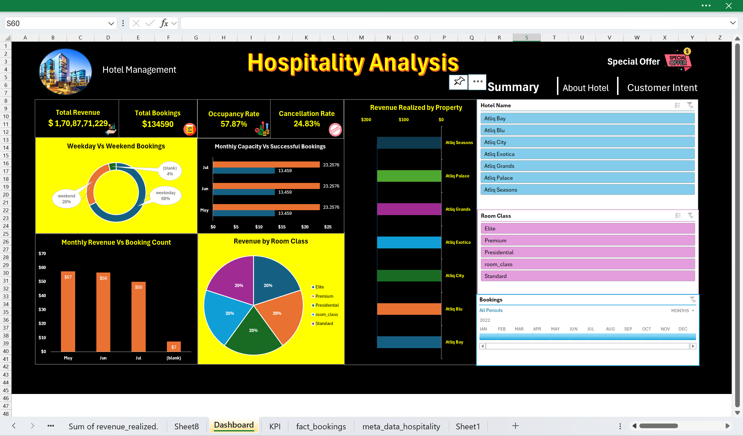
Excel Dashboard
Bank Analytics Dashboard:
Total Loan Amount of $446M, Total Annual Income of $279M, and Total Funded Amount of $435M. Loan amounts peaked in 2009-2010, then declined, with varied distribution across Grades A-G, especially Grade A since 2008. Loans vary by state (AK, AL, AR, AZ, CA) and month, with 59% verified and 41% non-verified payments.

Slide 7
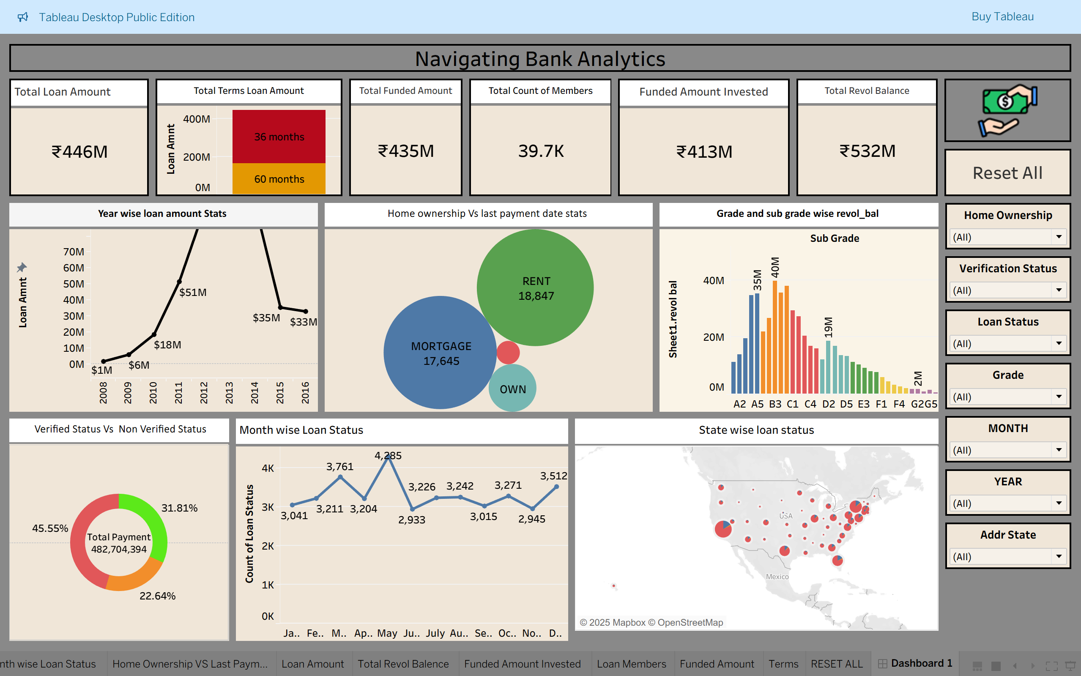
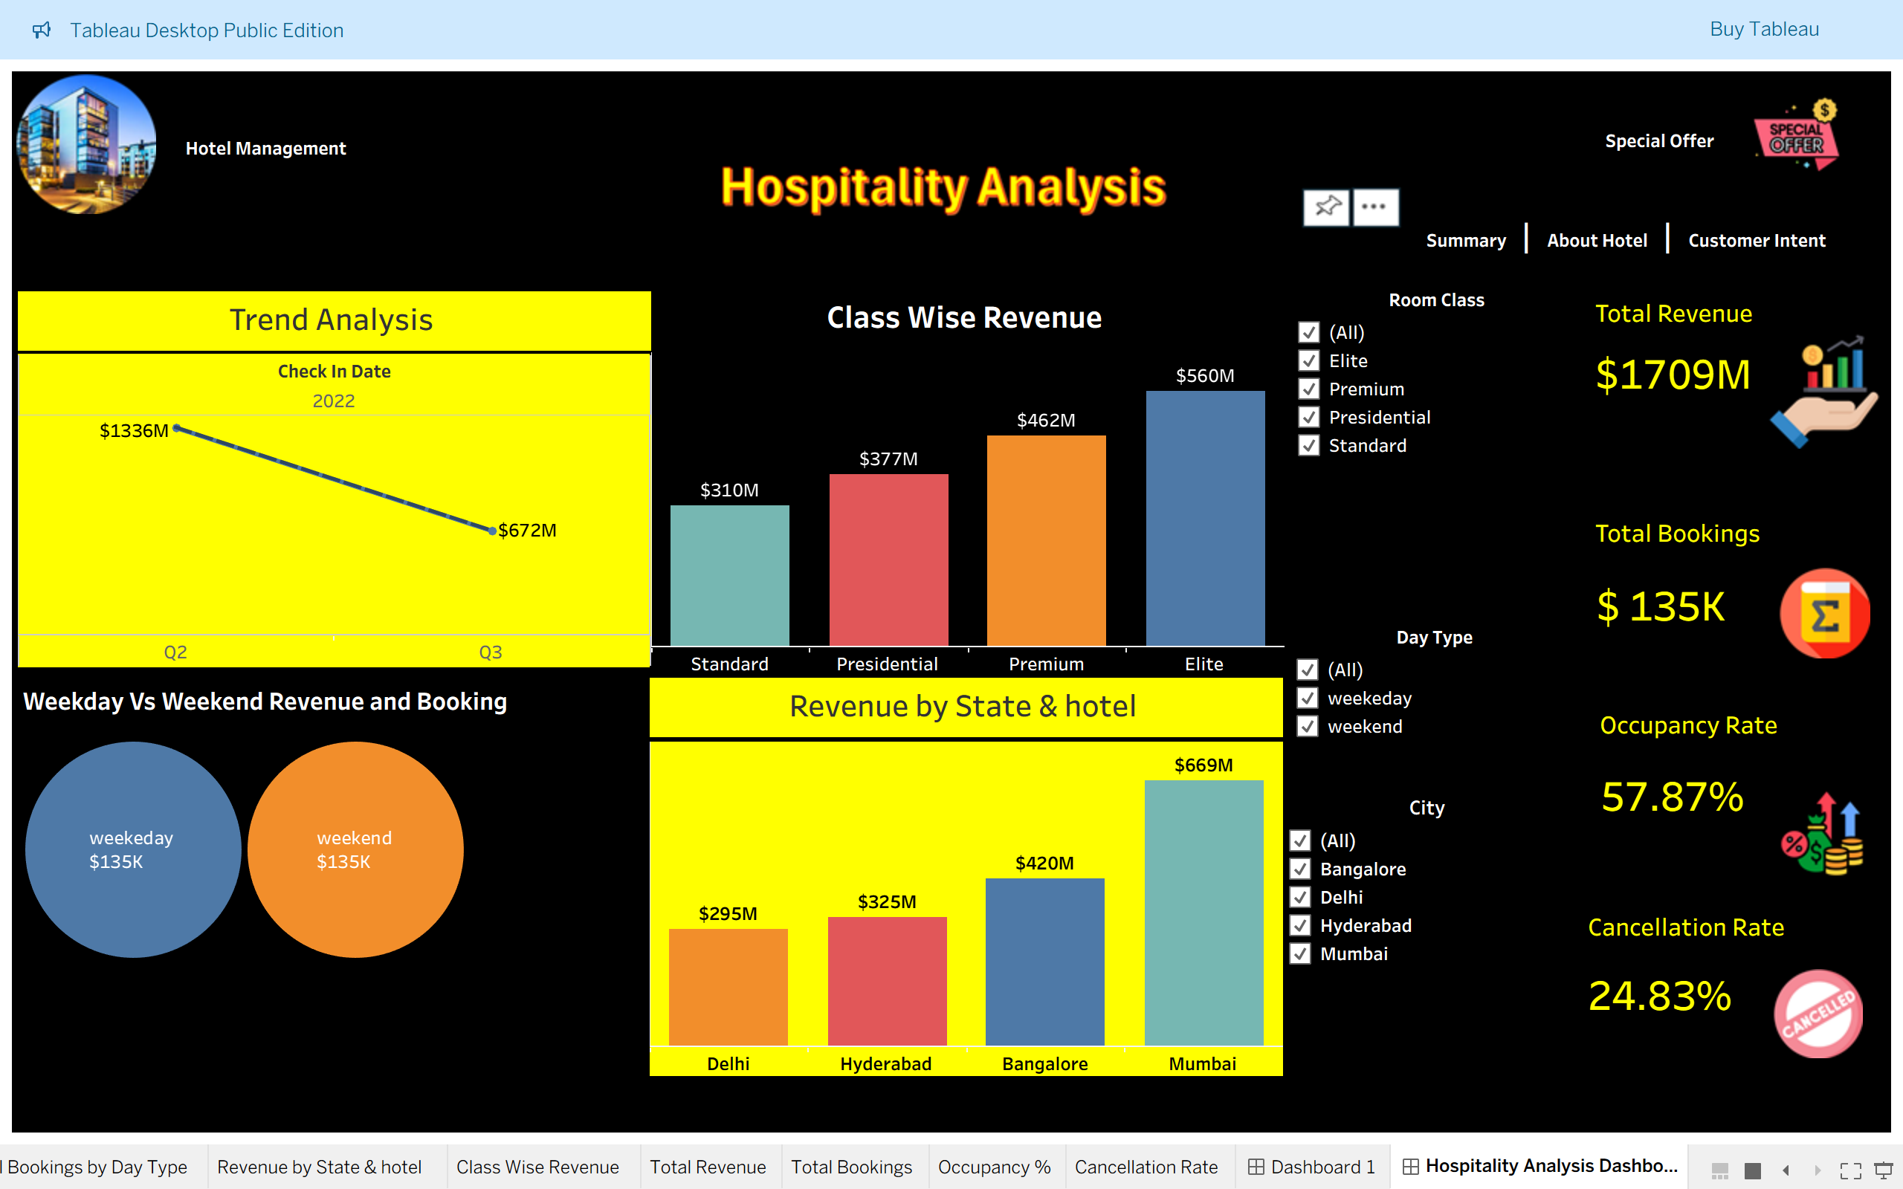
Hospitality Dashboard: Total Loan Amount: ₹446M, Total Terms Loan Amount: 36 months (dominant term), Total Funded Amount: ₹435M, Total Count of Members: 39.7K, Funded Amount Invested: ₹413M, Total Revo Balance: ₹532M
Tableau Dashboard

Slide 8
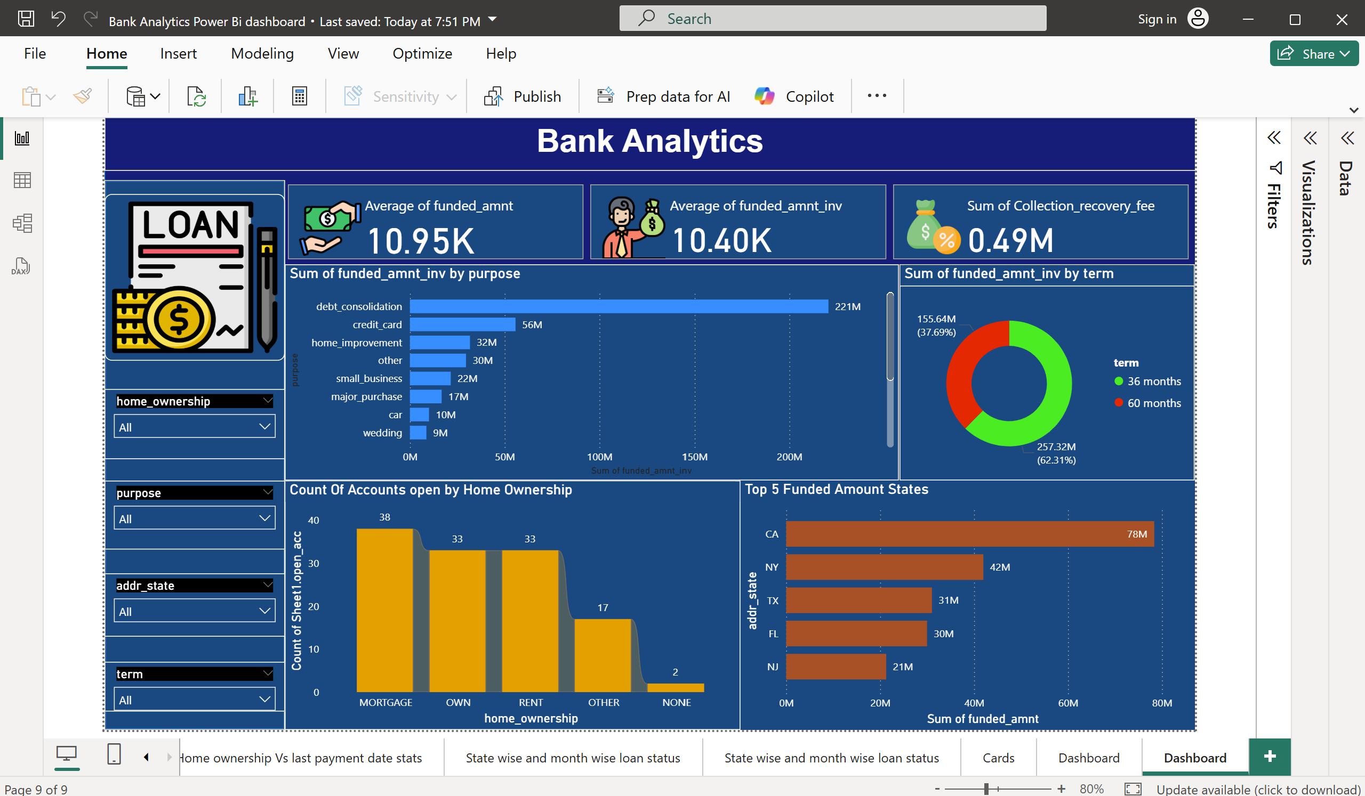
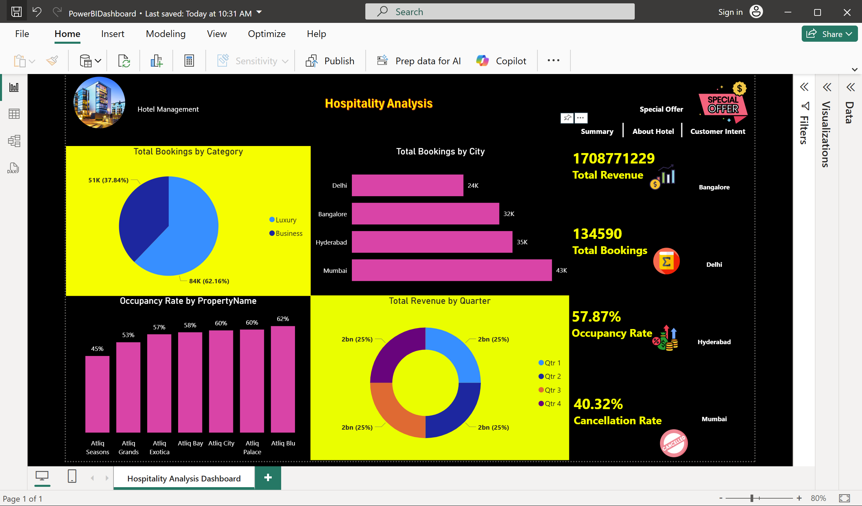
Power BI Dashboard
Hospitality Dashboard:
Average of Funded Amount: 10.95K,
Average of Funded Amount Invested: 10.40K
Sum of Collection Recovery Fee: 0.49M
Sum of Funded Amount Invested by Purpose: Debt consolidation (56M), credit card (22M), home improvement (10M), others
Sum of Funded Amount Invested by Term: 36 months (62.31%), 60 months (37.69%)

Slide 9
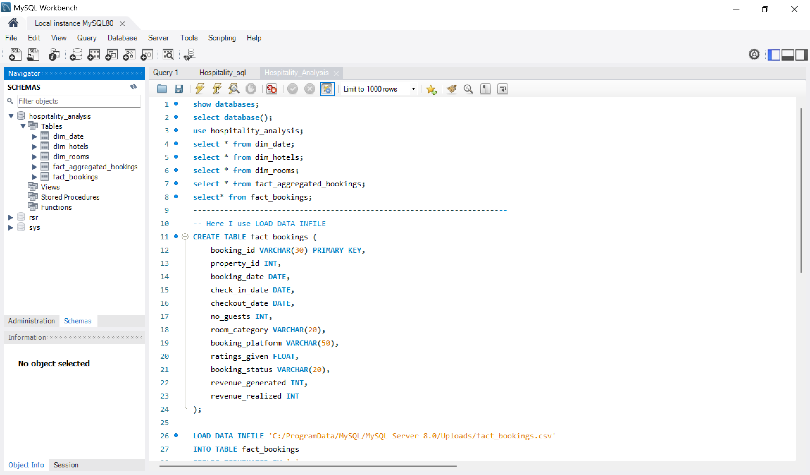
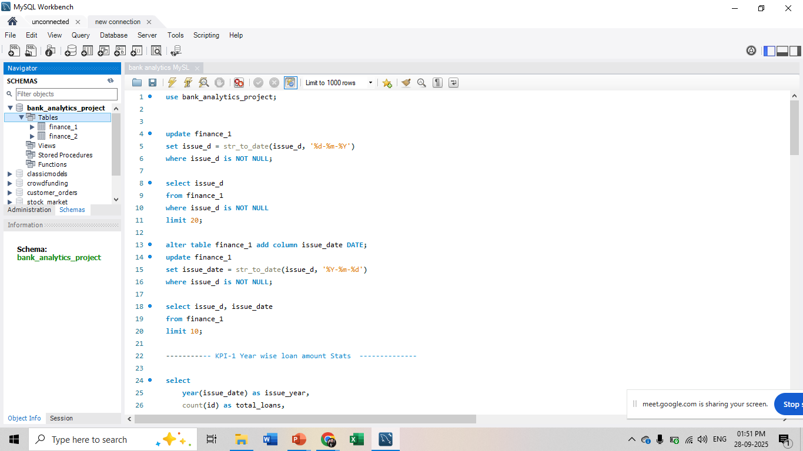
SQL Query Image

Slide 10
Key Takeaways
Key Takeaways
The total loan amount stands at $446M, with a total funded amount of $435M and an annual income of $279M, indicating strong financial activity.
Loan amounts have shown significant growth over the years, peaking at $51M recently, with a notable increase from $18M in 2008.
Home ownership status reveals RENT as the largest group (18,847), followed by MORTGAGE (17,645), and OWN with a smaller portion.
Verified loans account for 45.55% of total payments, while non-verified loans make up 31.81%, with the remaining 22.64% attributed to total payments.

Slide 11


